Slide 1
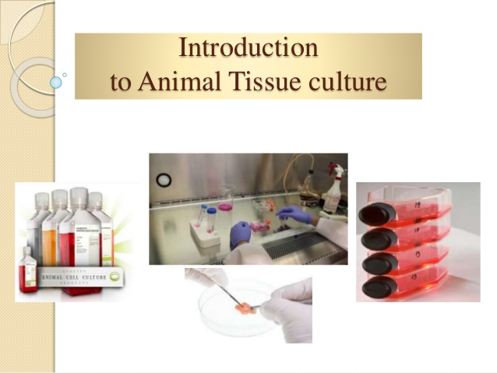

Slide 2
Cell culture
refers to the removal of cells from an animal or plant and their subsequent growth in a favorable artificial environment.
The cells may be removed from the tissue directly and disaggregated by enzymatic or mechanical means before cultivation, or they may be derived from a cell line or cell strain that has already been established.
Different types of cell grown in culture includes connective tissue elements such as fibroblasts, skeletal tissue, cardiac, epithelial tissue (liver, breast, skin, kidney) and many different types of tumor cells.

Slide 3
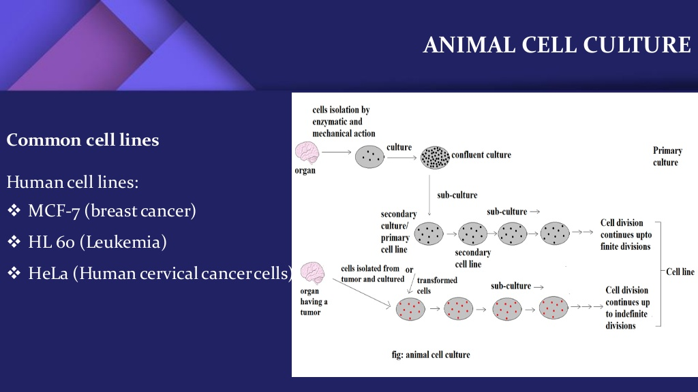

Slide 4
Primary Culture
Primary culture refers to the stage of the culture after the cells are isolated from the parental tissue and proliferated under the appropriate conditions until they occupy all of the available substrate (i.e., reach confluence). At this stage, the cells have to be subcultured (i.e., passaged) by transferring them to a new vessel with fresh growth medium to provide more room for continued growth.
Primary culture is the result of dissociation of cells from parental tissue cells through enzymatic mainly trypsin or mechanical measures and maintain growth of the cells in suitable conditions.
Such cultures comprise mostly heterogeneous cells and most of the cells divide for a limited time
These cells are similar to their parents

Slide 5
Primary cells have a finite life span
Primary culture contains a very heterogeneous population of cells
Sub culturing of primary cells leads to the generation of cell lines
Cell lines have limited life span, they passage several times before they become senescent
Cells such as macrophages and neurons do not divide in vitro so can be used as primary cultures
Lineage of cells originating from the primary culture is called a cell strain

Slide 6
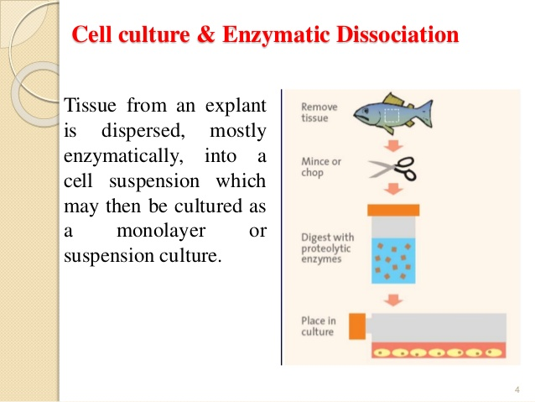

Slide 7
Adherent vs Suspension Culture
There are two basic systems for growing cells in culture, as monolayers on an artificial substrate (i.e., adherent culture) or free-floating in the culture medium (suspension culture).
The majority of the cells derived from vertebrates, with the exception of hematopoietic cell lines and a few others, are anchorage-dependent and have to be cultured on a suitable substrate that is specifically treated to allow cell adhesion and spreading (i.e., tissue-culture treated). However, many cell lines can also be adapted for suspension culture.

Slide 8
Adherent cells
Cells which are anchorage dependent and propagate as monolayer
Cells are washed with PBS (free of ca & mg ) solution. When dissociating the cells it is always recommended to use ca2+ and mg2+ free PBS. Bivalent ions are used by membrane adhesion proteins to create cell-cell and cell-substrate linking.
While passaged, a detaching agent (e.g., trypsin/EDTA to cover the monolayer and Incubate the plate at 37 C for 1-2 min) needs to be used to detach them from the surface. They re-attach to the surface within a few hours upon plating.
Fibroblasts and epithelial cells

Slide 9
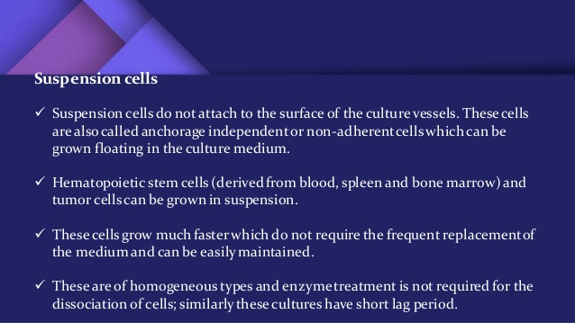

Slide 10
Confluence: For cells that grow as a monolayer, confluence is defined as the percentage of the culture vessel surface area that appears covered by a layer of cells when observed by microscopy. For example, 50% confluency means half of the surface of the culture dish, flask, etc. is covered in cells while 100 percent confluence means the surface is completely covered by the cells
Passage No: refers to how many times the cell has been sub-cultured
It gives an indication of how old the cells
Generation No: refers to the number of doublings that the cell population has undergone
Doubling time: the time required for a culture to double in number

Slide 11
Major development’s in cell culture technology
First development was the use of antibiotics which inhibits the growth of contaminants.
Second was the use of trypsin to remove adherent cells to subculture further from the culture vessel
Third was the use of chemically defined culture medium.

Slide 12
Cell Line
After the first subculture, the primary culture becomes known as a cell line or subclone. Cell lines derived from primary cultures have a limited life span.
As they are passaged, cells with the highest growth capacity predominate, resulting in a degree of genotypic and phenotypic uniformity in the population.
It is possible to select a particular cell lineage by cloning or physical cell separation or some other selection method
a cell line is a permanently established cell culture that will proliferate indefinitely given appropriate fresh medium and space.
As they are subcultured, they become different from the original cell.
No cell lines have been produced from avian tissues and the establishment of cell lines from human tissue is difficult

Slide 13
Finite vs continuous cell line
Finite cell line:
Normal cells usually divide only a limited number of times before losing their ability to proliferate, which is a genetically determined event known as senescence
Usually derived from primary cultures
Continuous cell line: some cell lines become immortal through a process called transformation, which can occur spontaneously or can be chemically or virally induced. When a finite cell line undergoes transformation and acquires the ability to divide indefinitely, it becomes a continuous cell line
Short generation time (12-24 h)
Have aneuploidy chromosome number
Are anchorage independent: divide and function in the absence of substratum
Less adherent, grow in suspension
Fast growth
Have the tendency to grow on top of each other forming multilayers
stop expressing tissue specific genes
different in phenotypes from donor tissue
Like cancer cell lines

Slide 14
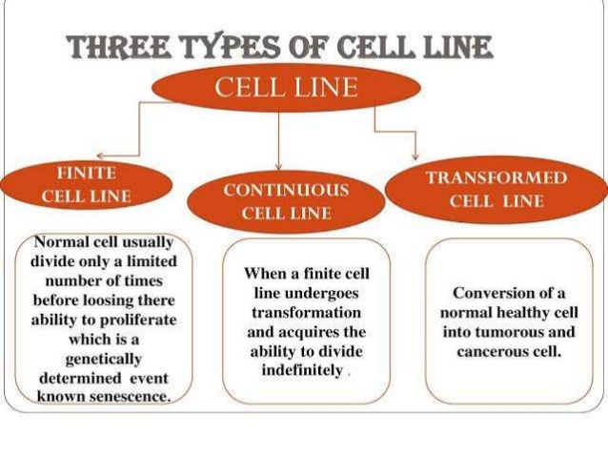

Slide 15
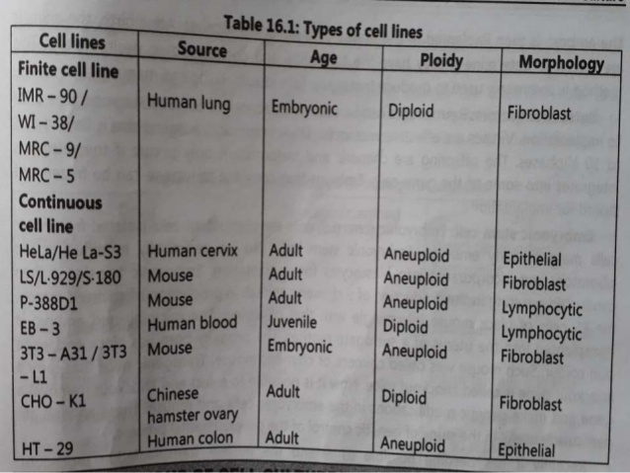

Slide 16
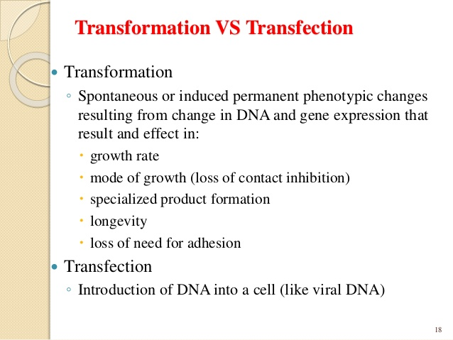

Slide 17
Culture Conditions
Culture conditions vary widely for each cell type, but the artificial environment in which the cells are cultured invariably consists of a suitable vessel containing a substrate or medium that supplies the essential nutrients (amino acids, carbohydrates, vitamins, minerals), growth factors, hormones, and gases (O2, CO2), and regulates the physicochemical environment (pH, osmotic pressure, temperature)

Slide 18
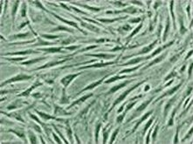
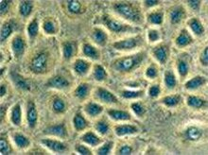
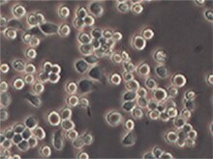
Morphology
Cells in culture can be divided in to three basic categories based on their shape and appearance (i.e., morphology).
1. Fibroblastic (or fibroblast-like) cells are bipolar or multipolar, have elongated shapes, and grow attached to a substrate.
2. Epithelial-like cells are polygonal in shape with more regular dimensions, and grow attached to a substrate in discrete patches.
3. Lymphoblast-like cells are spherical in shape and usually grown in suspension without attaching to a surface.
1
2
3

Slide 19
Applications of Cell Culture
Cell culture is one of the major tools used in cellular and molecular biology, providing excellent model systems for studying the normal physiology and biochemistry of cells (e.g., metabolic studies, aging),
the effects of drugs and toxic compounds on the cells, and mutagenesis and carcinogenesis.
It is also used in drug screening and development, and large scale manufacturing of biological compounds (e.g., vaccines, therapeutic proteins).
Virology
Cultivation of virus for vaccine production, also used to study there infectious cycle.
Genetic Engineering
Production of commercial proteins, large scale production of viruses for use in vaccine production e.g. polio, rabies, chicken pox, hepatitis B & measles
--The major advantage of using cell culture for any of the these applications is the consistency and reproducibility of results that can be obtained from using a batch of clonal cells.

Slide 20
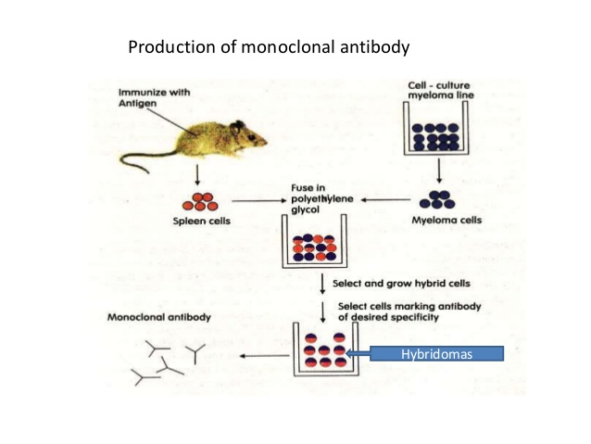

Slide 21
The TC lab
The location: the lab should not be situated near to any microbiological work area or animal house
Should not be open directly onto corridors with heavy pedestrian
Any windows should be permanently sealed to prevent dust
All the necessary manipulations involving cells should be confined strictly to TC lab with the exception of animal dissection
TC lab Should be kept totally free of unnecessary equipment
To facilitate cleaning, the walls should be painted with waterproof, oil-based gloss paint.
The primary cell line should never be kept in the same incubator or Laminar flow hood as hybridoma cells

Slide 22
Basic requirements
Cell culture hood (i.e., laminar-flow hood or biosafety cabinet)
• Incubator (humid CO2 incubator recommended)
• Water bath
• Centrifuge
• Refrigerator and freezer (–20°C)
• Cell counter (e.g., Countess® Automated Cell Counter or hemacytometer)
• Inverted microscope
• Liquid nitrogen (N2) freezer or cryostorage container
• Sterilizer (i.e., autoclave)

Slide 23
Expanded Equipment
Aspiration pump (peristaltic or vacuum)
• pH meter
• Confocal microscope
• Flow cytometer
Additional Supplies
Cell culture vessels (e.g., flasks, Petri dishes, roller bottles, multi-well plates)
Pipettes and pipettors
Syringes and needles
Waste containers, Media, sera, and reagents
Cells

Slide 24
Laminar Flow or Cell Culture Hood
provides an aseptic work area while allowing the containment of infectious splashes or aerosols generated by many microbiological procedures. Three kinds of cell culture hoods, designated as Class I, II and III, have been developed to meet varying research and clinical needs.
Classes of Cell Culture Hoods
-Class I cell culture hoods offer significant levels of protection to laboratory personnel and to the environment when used with good microbiological techniques, but they do not provide cultures protection from contamination or cells of human origin.
-Class II cell culture hoods provide an aseptic environment necessary for cell culture experiments. A Class II biosafety cabinet should be used for handling potentially hazardous materials (e.g., primate-derived cultures, virally infected cultures, radioisotopes, carcinogenic or toxic reagents).
-Class III biosafety cabinets are gas-tight, and they provide the highest attainable level of protection to personnel and the environment. A Class III biosafety cabinet is required for work involving known human pathogens . Air-Flow Characteristics of Cell Culture Hoods Cell culture hoods protect the working environment from dust and other airborn contaminants by maintaining a constant, unidirectional flow of HEPA-filtered air over the work area.

Slide 25
Horizontal vs vertical hoods
The flow can be horizontal, blowing parallel to the work surface, or it can be vertical, blowing from the top of the cabinet onto the work surface.
Depending on its design, a horizontal flow hood provides protection to the culture (if the air flowing towards the user) or to the user (if the air is drawn in through the front of the cabinet by negative air pressure inside). Vertical flow hoods, on the other hand, provide significant protection to the user and the cell culture
Prefilter removes most particulate matter while the high efficiency particle filters (HEPA) capable of removing from air particulate matter that is greater than 0.3 um in diameter. This means that most but not all bac and fungi spores will be removed.
The air flow should be measured regularly with an anemometer to ensure that it is both steady and up to specifications

Slide 26
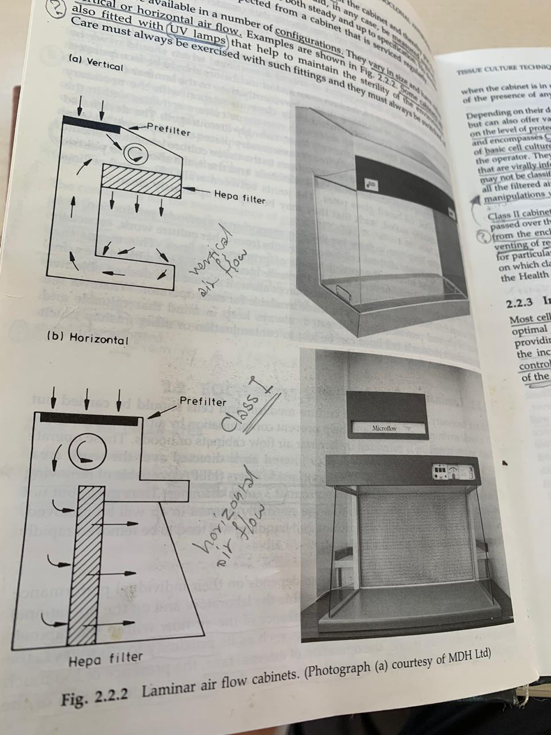

Slide 27
Incubator
The purpose of the incubator is to provide the appropriate environment for cell growth. The incubator should be large enough for your laboratory needs, have forced air circulation, and should have temperature control to within ±0.2°C. Stainless steel incubators allow easy cleaning and provide corrosion protection, especially if humid air is required for incubation.
frequent cleaning of the incubator is essential to avoid contamination of cell cultures.
Types of Incubators:
There are two basic types of incubators, dry incubators and humid 5% CO2 incubators. Dry incubators are more economical, but require the cell cultures to be incubated in sealed flasks to prevent evaporation. Placing a water dish in a dry incubator can provide some humidity, but they do not allow precise control of atmospheric conditions in the incubator.
Humid CO2 incubators are more expensive, but allow superior control of culture conditions. They can be used to incubate cells cultured in Petri dishes or multi-well plates, which require a controlled atmosphere of high humidity and increased CO2 tension.

Slide 28
Refrigerators :For small cell culture laboratories, a domestic refrigerator (preferably one without a autodefrost freezer) is an adequate and inexpensive piece of equipment for storing reagents and media at 2–8°C. For larger laboratories, a cold room restricted to cell culture is more appropriate. Make sure that the refrigerator or the cold room is cleaned regularly to avoid contamination.
Centrifuge: refrigerated bench at rates of 1500 rpm or 499 g.

Slide 29
Inverted microscope:
essential for daily observation of cells in culture for the assessment of cell growth and detection of possible infection.
For Hybridoma work, a 10x and 20x objective with 10-15 eye piece give sufficient magnification

Slide 30
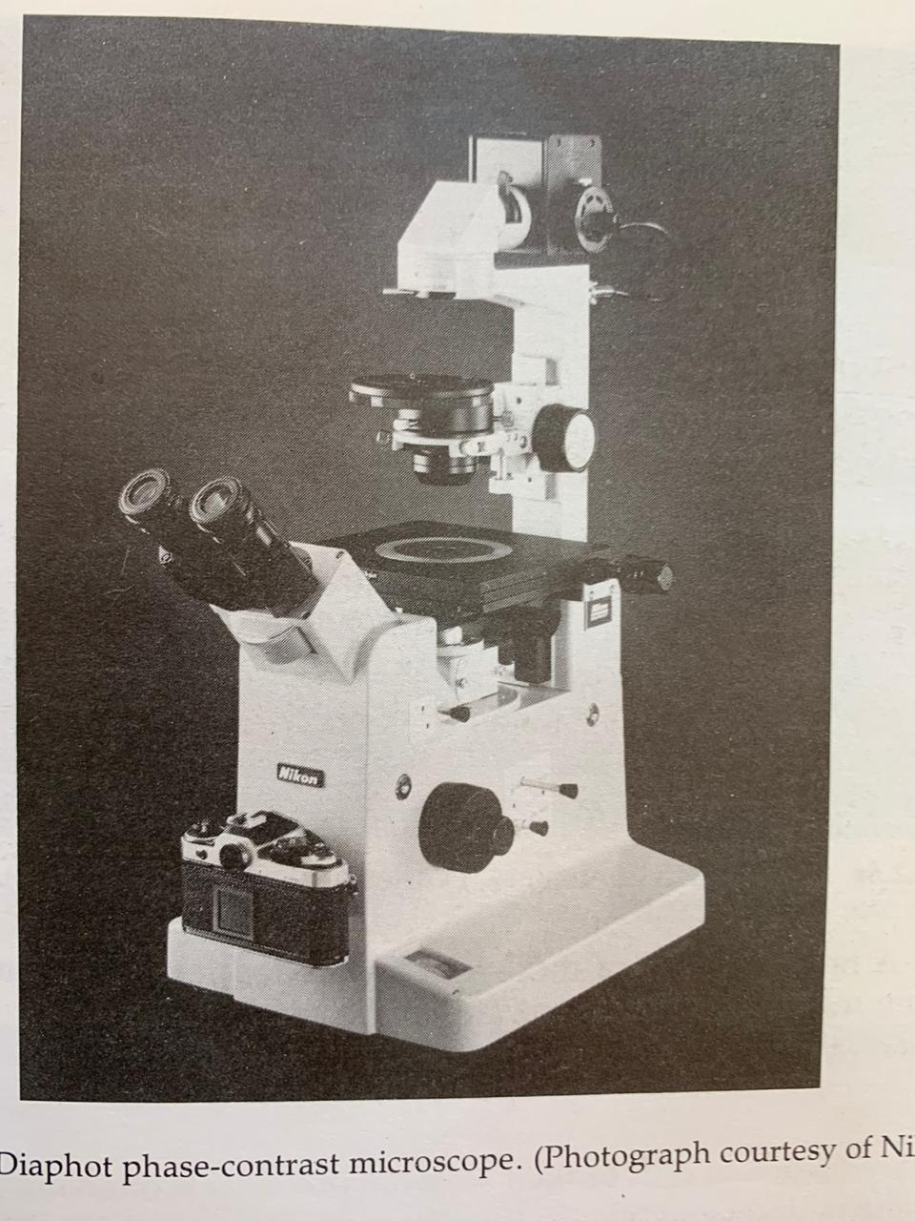
Inverted microscope

Slide 31
Liquid N2:
Cryogenic Storage Cell lines in continuous culture are likely to suffer from genetic instability as their passage number increases; therefore, it is essential to prepare working stocks of the cells and preserve them in cryogenic storage. Do not store cells in –20°C or –80°C freezers, because their viability quickly decreases when they are stored at these temperatures.
The long storage is liquid-nitrogen systems, at -196⁰C vapor phase and liquid phase, which come as wide-necked or narrow-necked storage containers. Vapor phase systems minimize the risk of explosion with cryostorage tubes, and are required for storing biohazardous materials, while the liquid phase systems usually have longer static holding times, and are therefore more economical.

Slide 32
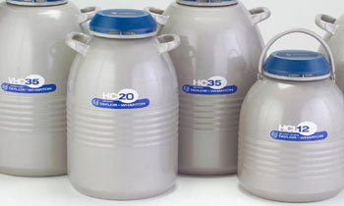
L nitrogen containers

Slide 33
Cell Counter
A cell counter is essential for quantitative growth kinetics, and a great advantage when more than two or three cell lines are cultured in the laboratory.
The Countess® Automated Cell Counter is a bench-top instrument designed to measure cell count and viability (live, dead, and total cells) accurately and precisely in less than a minute per sample, using the standard Trypan Blue uptake technique. Using the same amount of sample that you currently use with the hemacytometer, the Countess® Automated Cell Counter takes less than a minute per sample for a typical cell count and is compatible with a wide variety of eukaryotic cells.

Slide 34
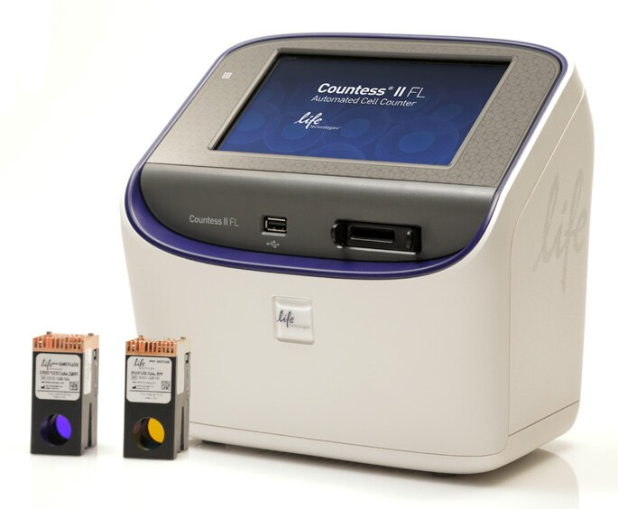
Cell counter

Slide 35
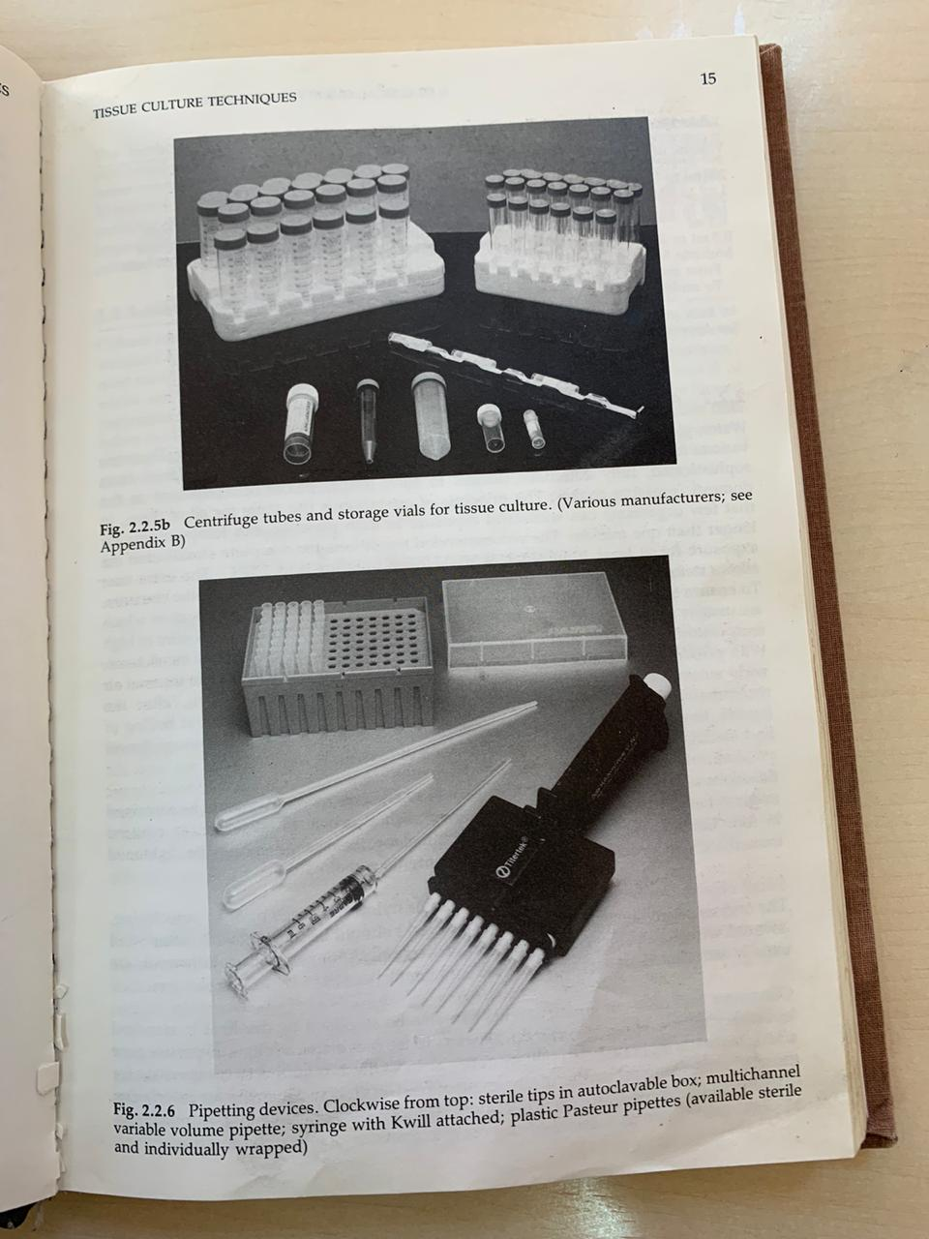
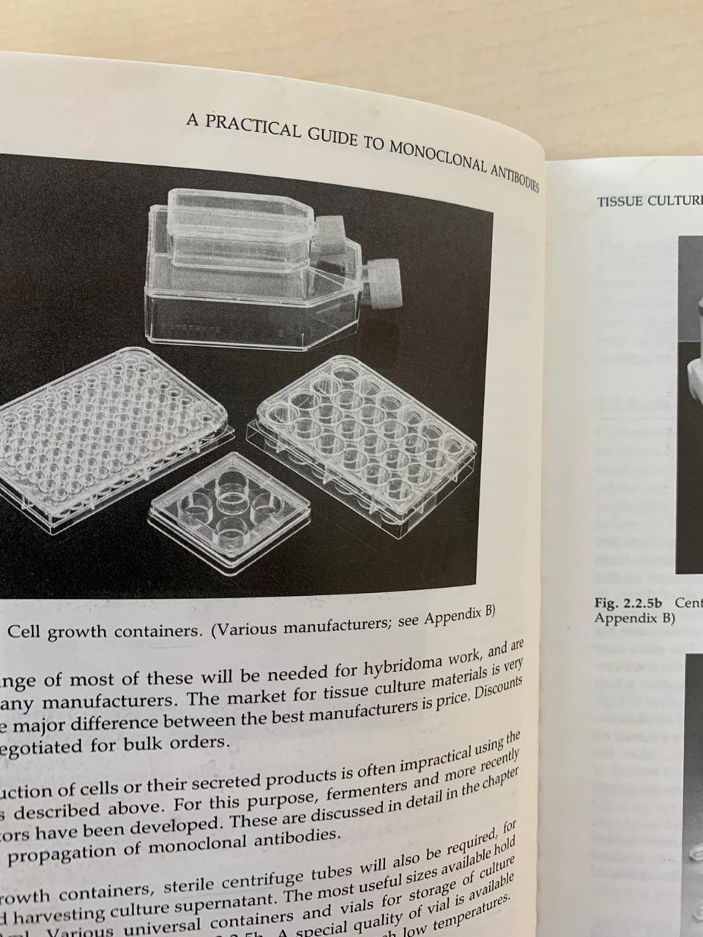
consumables

Slide 36
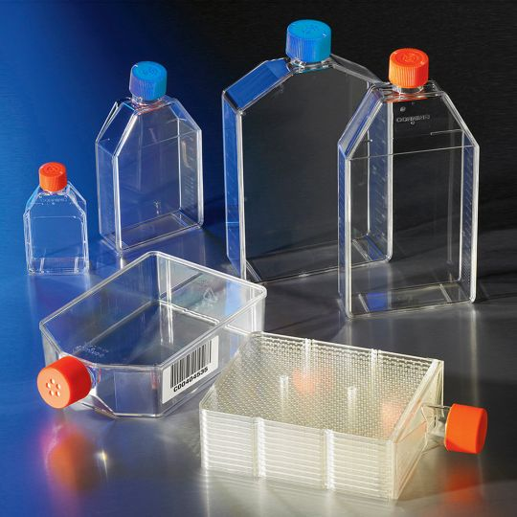
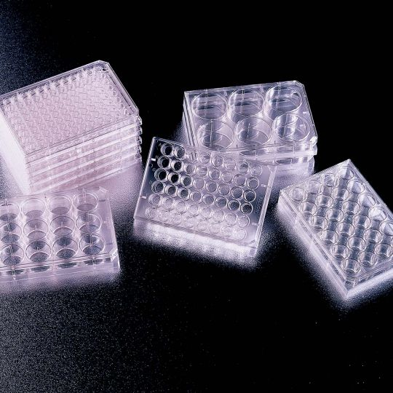

Slide 37
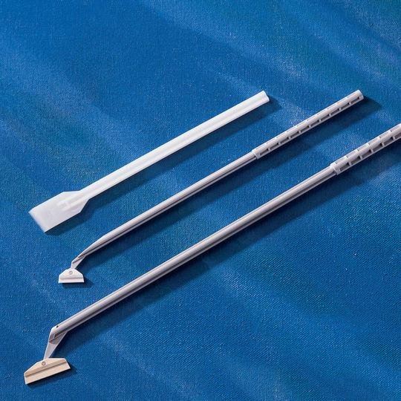
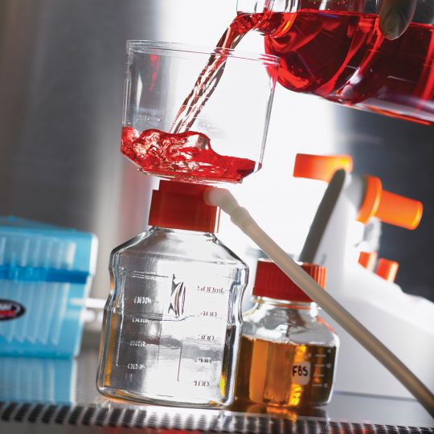

Slide 38
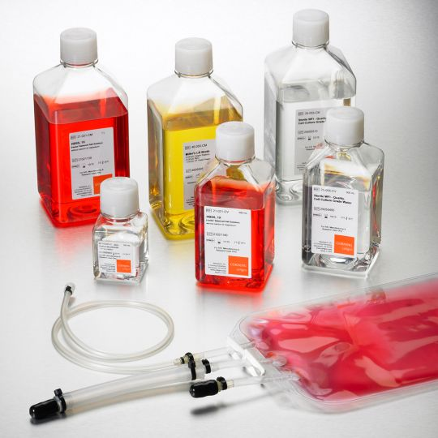
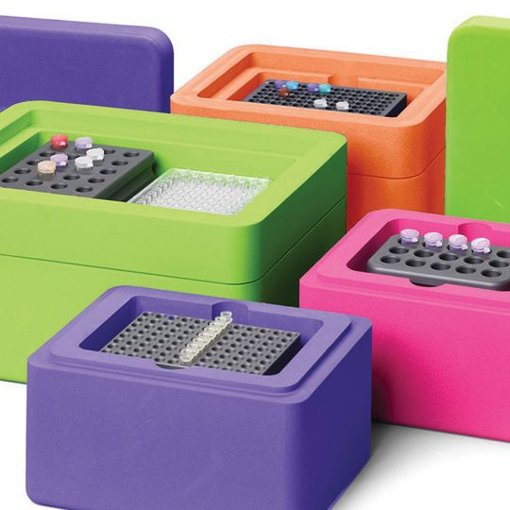

Slide 39


Slide 40


Slide 41
Autoclave and oven
Complete sterilisation are exposure for at least 20 min at 10-15 lb/in2 pressure and 120⁰C.
Solutions in glass bottles loosely fitted screw cap. On removing bottles from autoclave caps should be tightened immediately
Glass pipettes plugged with cotton wool are autoclaved in a sealable metal container. Disposable sterile pipettes are available
Glassware and dissecting sets can be sterilized by dry heat in the oven 90 min at 160⁰C. Disposable sterile Culture flasks are available
Media is only sterilized by filtration and should not be autoclaved because Gln will be damaged, using 0.45 um filters prior to 0.2 um

Slide 42
Storage
Culture media is stored at 4⁰C
Storage of FCS at -20⁰C
Short-term storage of cells at -80⁰C
Long-term storage of cells at L nitrogen

Slide 43
Routine cleaning the TC lab
Daily tasks
-Mop the floor with detergent at the end of the day
Weekly tasks
-Wipe all general surfaces with 70% alcohol
-wash L flow with detergent followed by 70% alcohol
-replace the humidity water in the incubator
-pour disinfectant in the sink
Every 3 months
-dismantle the inside of the incubator wash with detergent and alcohol
-wash prefilter of L flow with detergent rinse and replace

Slide 44
Personal hygiene
-Wear a clean lab coat reserved for tc
-Disposable foot cover
-Paper hairnet
-Try not to sneeze or talk while working
-wash hands before and after work
-Fingernails should be cut
-No food or drinks

Slide 45
Sterile Work Area
The simplest and most economical way to reduce contamination from airborne particles and aerosols (e.g., dust, spores, shed skin, sneezing) is to use a cell culture hood.
The cell culture hood should be properly set up and be located in an area that is restricted to cell culture that is free from drafts from doors, windows, and other equipment, and with no through traffic.
The work surface should be uncluttered and contain only items required for a particular procedure; it should not be used as a storage area.
Before and after use, the work surface should be disinfected thoroughly, and the surrounding areas and equipment should be cleaned routinely.
For routine cleaning, wipe the work surface with 70% ethanol before and during work, especially after any spillage.
You may use ultraviolet light to sterilize the air and exposed work surfaces in the cell culture hood between uses
Using a Bunsen burner for flaming is not necessary nor recommended in a cell culture hood.
Leave the cell culture hood running at all times, turning them off only when they will not be used for extended periods of time.

Slide 46
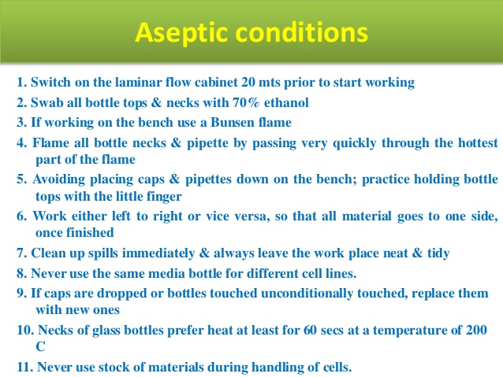

Slide 47
Media
The culture medium is the most important component of the culture environment, because it provides the necessary nutrients, growth factors, and hormones for cell growth, as well as regulating the pH and the osmotic pressure of the culture.
Liquid vs powder media
Powders are cheaper, take up less storage space, and have longer shelf life.
Large volumes of water will be needed for reconstitution and take longer to prepare. Liquid media should be kept no longer than 1 year whereas powders can be kept for 2 years.
Commonly used media: RPMI 1640, DMEM

Slide 48
Essential additives
PH
Most normal mammalian cell lines grow well at pH 7.4
Most human and mammalian cell lines are maintained at 36°C to 37°C for optimal growth.
-bicarbonate buffer
-Na pyruvate increase production of endogenous CO2
-HEPES: avoided at fusion experiment
-Atmospheric CO2 5%
Phenol red is incorporated as a PH indicator:
purple PH 7.8, red PH 7.4, orange at PH 7 and yellow at PH 6.5
2. Glutamine:
Unstable in solution: 3 weeks at 4⁰C and 1 week at 37⁰C
Purchased as 100x frozen or lyophilized powder
3. Serum
0 or serum free washing media
5-10% fetal calf serum hybridoma culture
20% FCS Fusion and cloning
90% storage hybridoma in liquid N2

Slide 49
4. Antibiotics
Penicillin 100U/ml (gram +) and Streptomycin 100 ug/ml (gram -)
5. Beta-mercaptoethanol
Enhance Ab production by spleen cells and renders hybridoma less
dependent on particular patches of serum
-Media is only sterilized by filtration and should not be autoclaved because Gln will be damaged, using 0.45 um filters prior to 0.2 um
-Avoid multiple sampling of stock solution to minimize contamination
-Sterility testing:
Small sample of medium in a sealed bottle at R.T. for few days

Slide 50
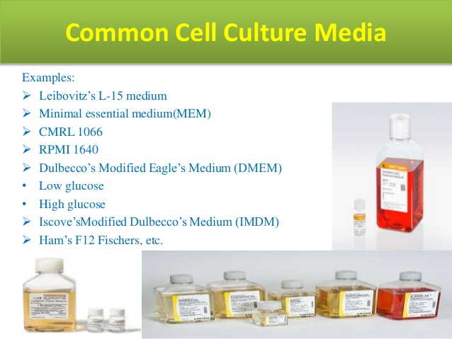

Slide 51
Contamination
Contamination of cell cultures is easily the most common problem encountered in cell culture laboratories, sometimes with very serious consequences. Cell culture contaminants can be divided into two main categories, chemical contaminants such as impurities in media, sera, and water, endotoxins, plasticizers, and detergents, and biological contaminants such as bacteria, molds, yeasts, viruses, mycoplasma, as well as cross contamination by other cell lines.
Bacteria:
Because of their ubiquity, size, and fast growth rates, bacteria, along with yeasts and molds, are the most commonly encountered biological contaminants in cell culture.
Bacterial contamination is easily detected by visual inspection of the culture within a few days of it becoming infected; infected cultures usually appear cloudy (i.e., turbid), sometimes with a thin film on the surface.
Sudden drops in the pH of the culture medium is also frequently encountered.
Under a low power microscope, the bacteria appear as tiny, moving granules between the cells, and observation under a high-power microscope can resolve the shapes of individual bacteria.
Recommended antibiotics: Pen & strep & Gentamicin

Slide 52
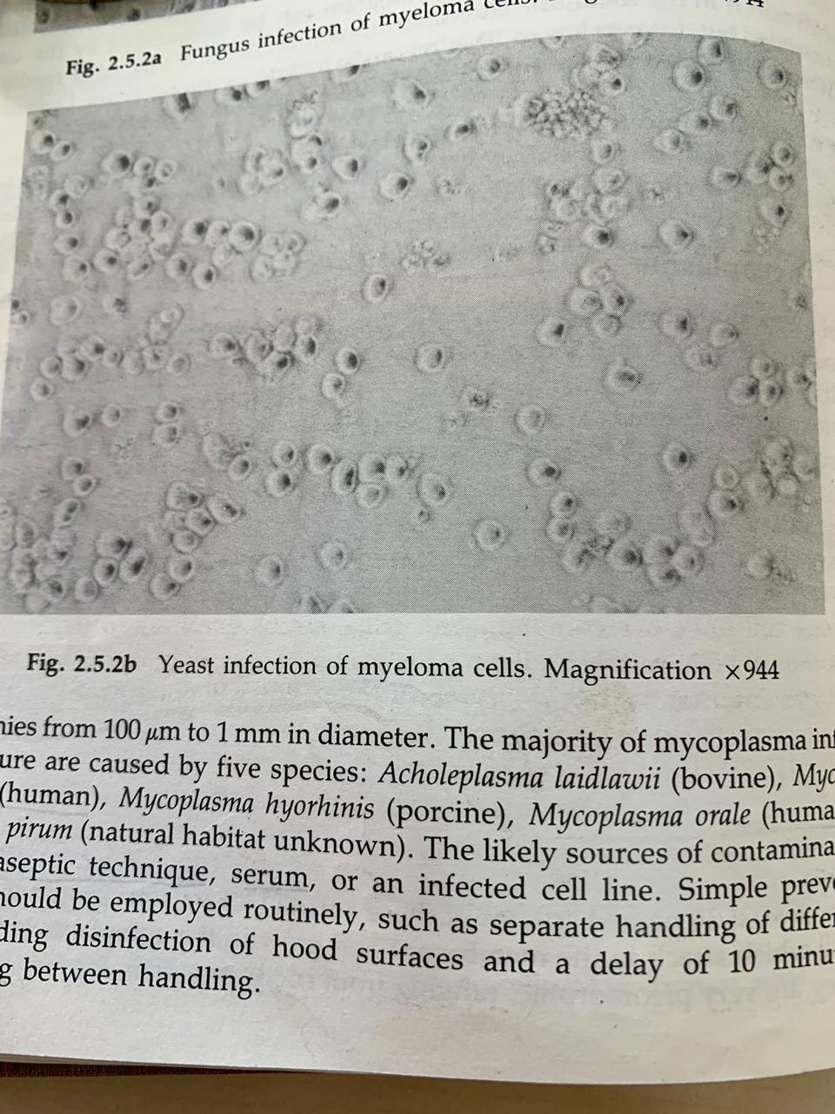
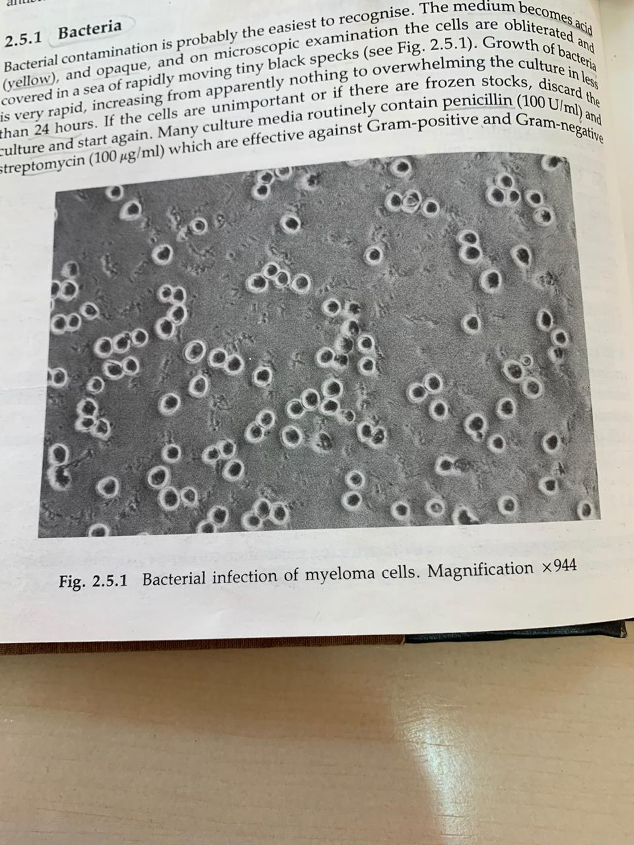

Slide 53
Yeasts
are unicellular eukaryotic microorganisms in the kingdom of Fungi, ranging in size from a few micrometers (typically) up to 40 micrometers (rarely).
cultures contaminated with yeasts become turbid, especially if the contamination is in an advanced stage.
There is very little change in the pH of the culture contaminated by yeasts until the contamination becomes heavy, at which stage the pH usually increases.
Under microscopy, yeast appear as individual ovoid or spherical particles, that may bud off smaller particles
Can be avoided by the use of amphotericin B or nystatin

Slide 54
Mycoplasma
Mycoplasma are simple bacteria that lack a cell wall, and they are considered the smallest self-replicating organism. Because of their extremely small size (typically less than one micrometer), mycoplasma are very difficult to detect until they achieve extremely high densities and cause the cell culture to deteriorate; until then, there are often no visible signs of infection.
the only assured way of detecting mycoplasma contamination is by testing the cultures periodically using fluorescent staining (e.g., Hoechst ), ELISA, PCR.
Treated with Tylosin

Slide 55
Viruses
events are a rare occurrence in the biopharmaceutical industry.
Sources of viral contamination include raw materials, open vessel operations, and other less obvious sources. Small, non-enveloped viruses are the most worrisome of the viral contaminants
Contamination of cell cultures with viruses raises a range of greater potential problems than with other microorganisms:
a. This is firstly because of the difficulty in specifically detecting and identifying viral contaminants which often do not produce any cytopathic effect,
b. and secondly because of inability to eradicate them once they have established a persistent infection.
These problems stem from their very small size (varying from approximately 25–500 nm in diameter), and from their existence as obligate intracellular parasites.

Slide 56
Because most viruses have very stringent requirements for their host, they usually do not adversely effect cell cultures from species other than their host.
However, using virally infected cell cultures can present a serious health hazard to the laboratory personnel, especially if human or primate cells are cultured in the laboratory.
Some viral contamination present a serious threat because of the difficulty in detecting some viruses and the lack of effective methods of treating infected cell cultures.
While some viruses are capable of causing morphological changes to infected cells (e.g. cytopathic effect)which are detectable by microscopy some viral contaminations result in the integration of the viral genome as provirus, this causes no visual evidence, by means of modification of the cellular morphology.
Viral infection of cell cultures can be detected by ELISA assays, or PCR

Slide 57
Virus production from such cell lines, are potentially dangerous for other cell cultures (in research labs) by cross contaminations, or for operators and patients (in the case of the production of injectable biologicals) because of potential infection.
The only way to keep cell cultures for research, development, and the biotech industry virus-free is the prevention of such contaminations. Cell cultures can become contaminated by the following means:
-firstly, they may already be contaminated as primary cultures (because the source of the cells was already infected),
- secondly, they were contaminated due to the use of contaminated raw materials,
- thirdly, they were contaminated via an animal passage.

Slide 58
Chemical contamination,
often overlooked as a cause of cell growth problems, is caused by nonliving substances that produce unwanted effects on a culture system. These can include everything from media, sera, water and endotoxins to storage vessels, fluorescent lights and incubators.

Slide 59
Subculturing
What is Subculture?
Subculturing, also referred to as passaging, is the removal of the medium and transfer of cells from a previous culture into fresh growth medium, a procedure that enables the further propagation of the cell line or cell strain.
The growth of cells in culture proceeds from the lag phase following seeding to the log phase, where the cells proliferate exponentially. When the cells in adherent cultures occupy all the available substrate and have no room left for expansion, or when the cells in suspension cultures exceed the capacity of the medium to support further growth, cell proliferation is greatly reduced or ceases entirely. To keep them at an optimal density for continued growth and to stimulate further proliferation, the culture has to divided and fresh medium supplied.

Slide 60
Once the available substrate surface is covered by cells (a confluent culture) growth slows & ceases.
Cells to be kept in healthy & in growing state have to be sub-cultured or passaged
It’s the passage of cells when they reach to 80-90% confluency in flask/dishes/plates
Enzyme such as trypsin, dipase, collagenase in combination with EDTA breaks the cellular glue that attached the cells to the surface

Slide 61
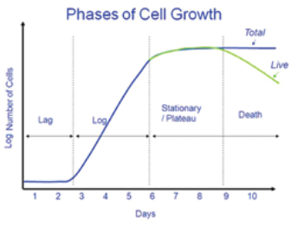

Slide 62
When to Subculture?
The criteria for determining the need for subculture are similar in adherent and suspension cultures
Cell density: Adherent cultures should be passaged when they are in the log phase, before they reach confluence. Normal cells stop growing when they reach confluence (contact inhibition), and it takes them longer to recover when reseeded. Transformed cells can continue proliferating even after they reach confluence, but they usually deteriorate after about two doublings. Similarly, cells in suspension should be passaged when they are in log-phase growth before they reach confluency. When they reach confluency, cells in suspension clump together and the medium appears turbid when the culture flask is swirled.
Deterioration of morphology
A drop in the pH of the growth medium usually indicates a build up of lactic acid, which is a by-product of cellular metabolism. Lactic acid can be toxic to the cells, and the decreased pH can be sub-optimal for cell growth. The rate of change of pH is generally dependent on the cell concentration in that cultures at a high cell concentration exhaust medium faster than cells lower concentrations. You should subculture your cells if you observe a rapid drop in pH (> 0.1–0.2 pH units) with an increase in cell concentration.

Slide 63
Aseptic technique video
https://www.youtube.com/watch?v=nr1tV_LuqJk
Basic tissue culture (subculturing) video
https://www.youtube.com/watch?v=CMRKKl9XSDU

